Slide 1
Weekly Progress
Classification
k-fold stratified cross validations
Correlation columns grouping
Corr, ABS(Corr), Corr^2
Higher difference correlation within group
Trying with classification benchmark problem?
Grouping with columns sequence?

Slide 2
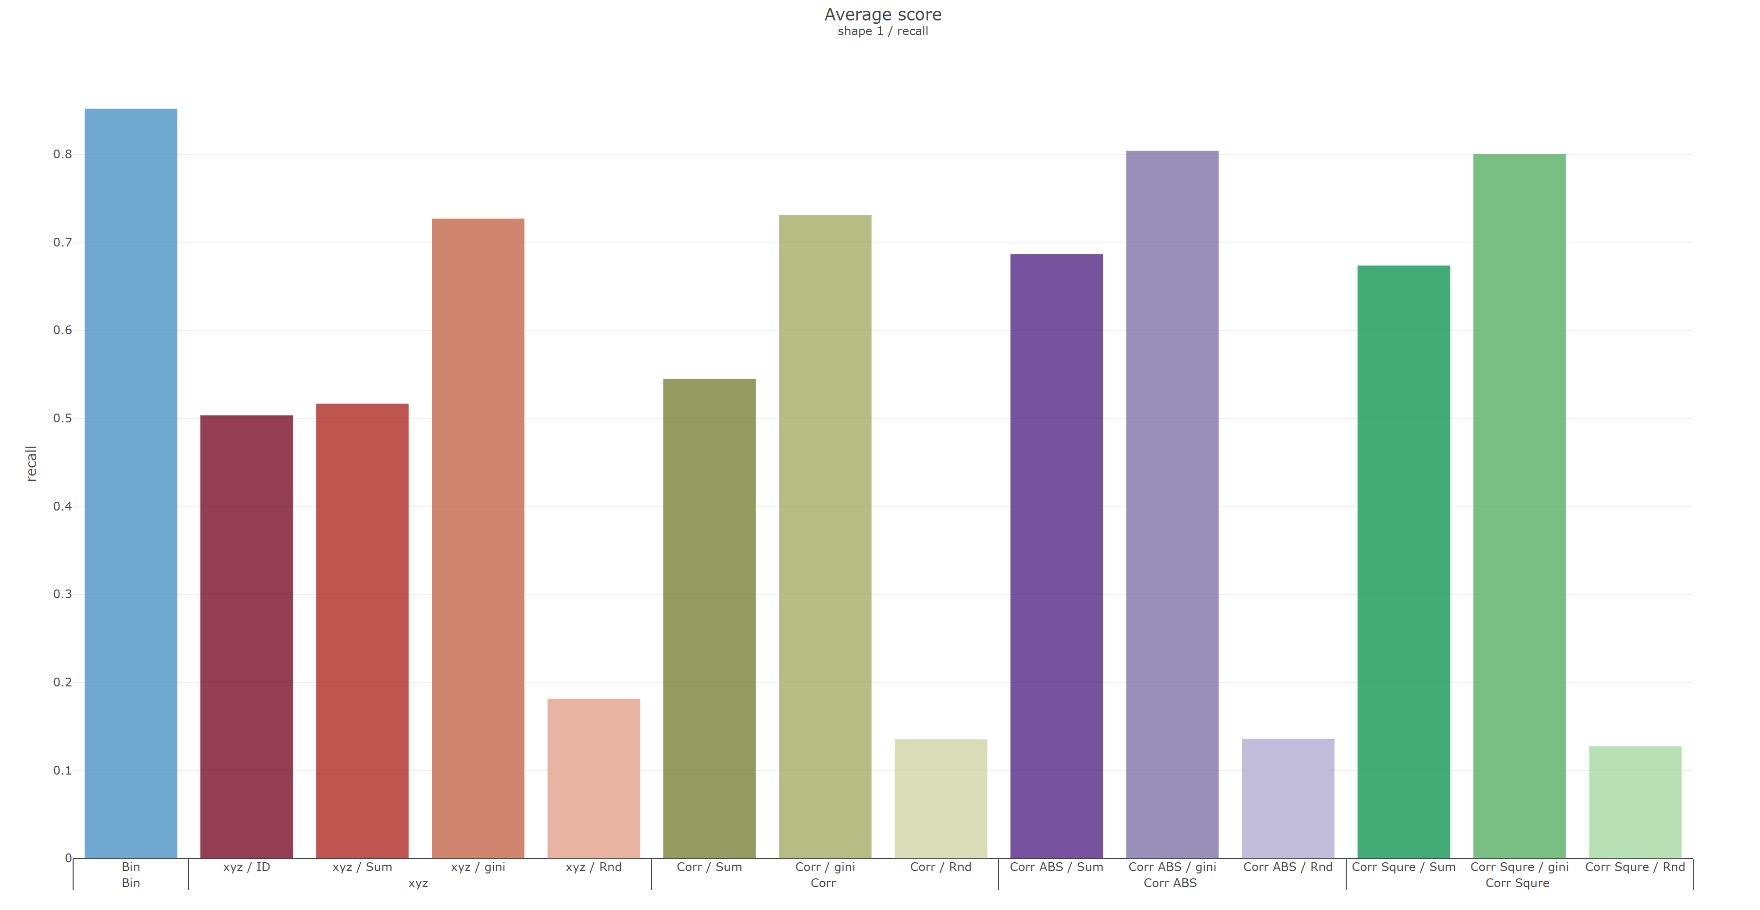
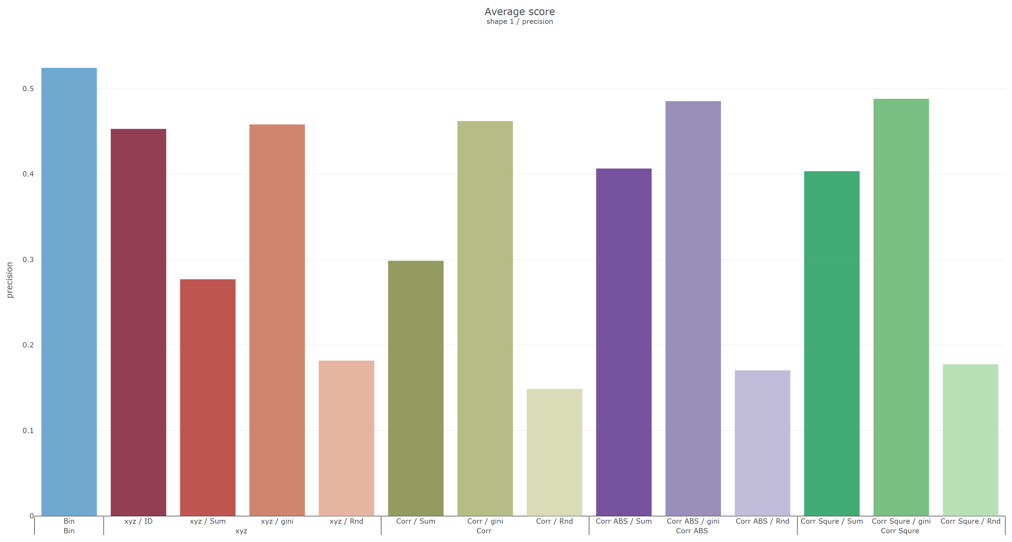
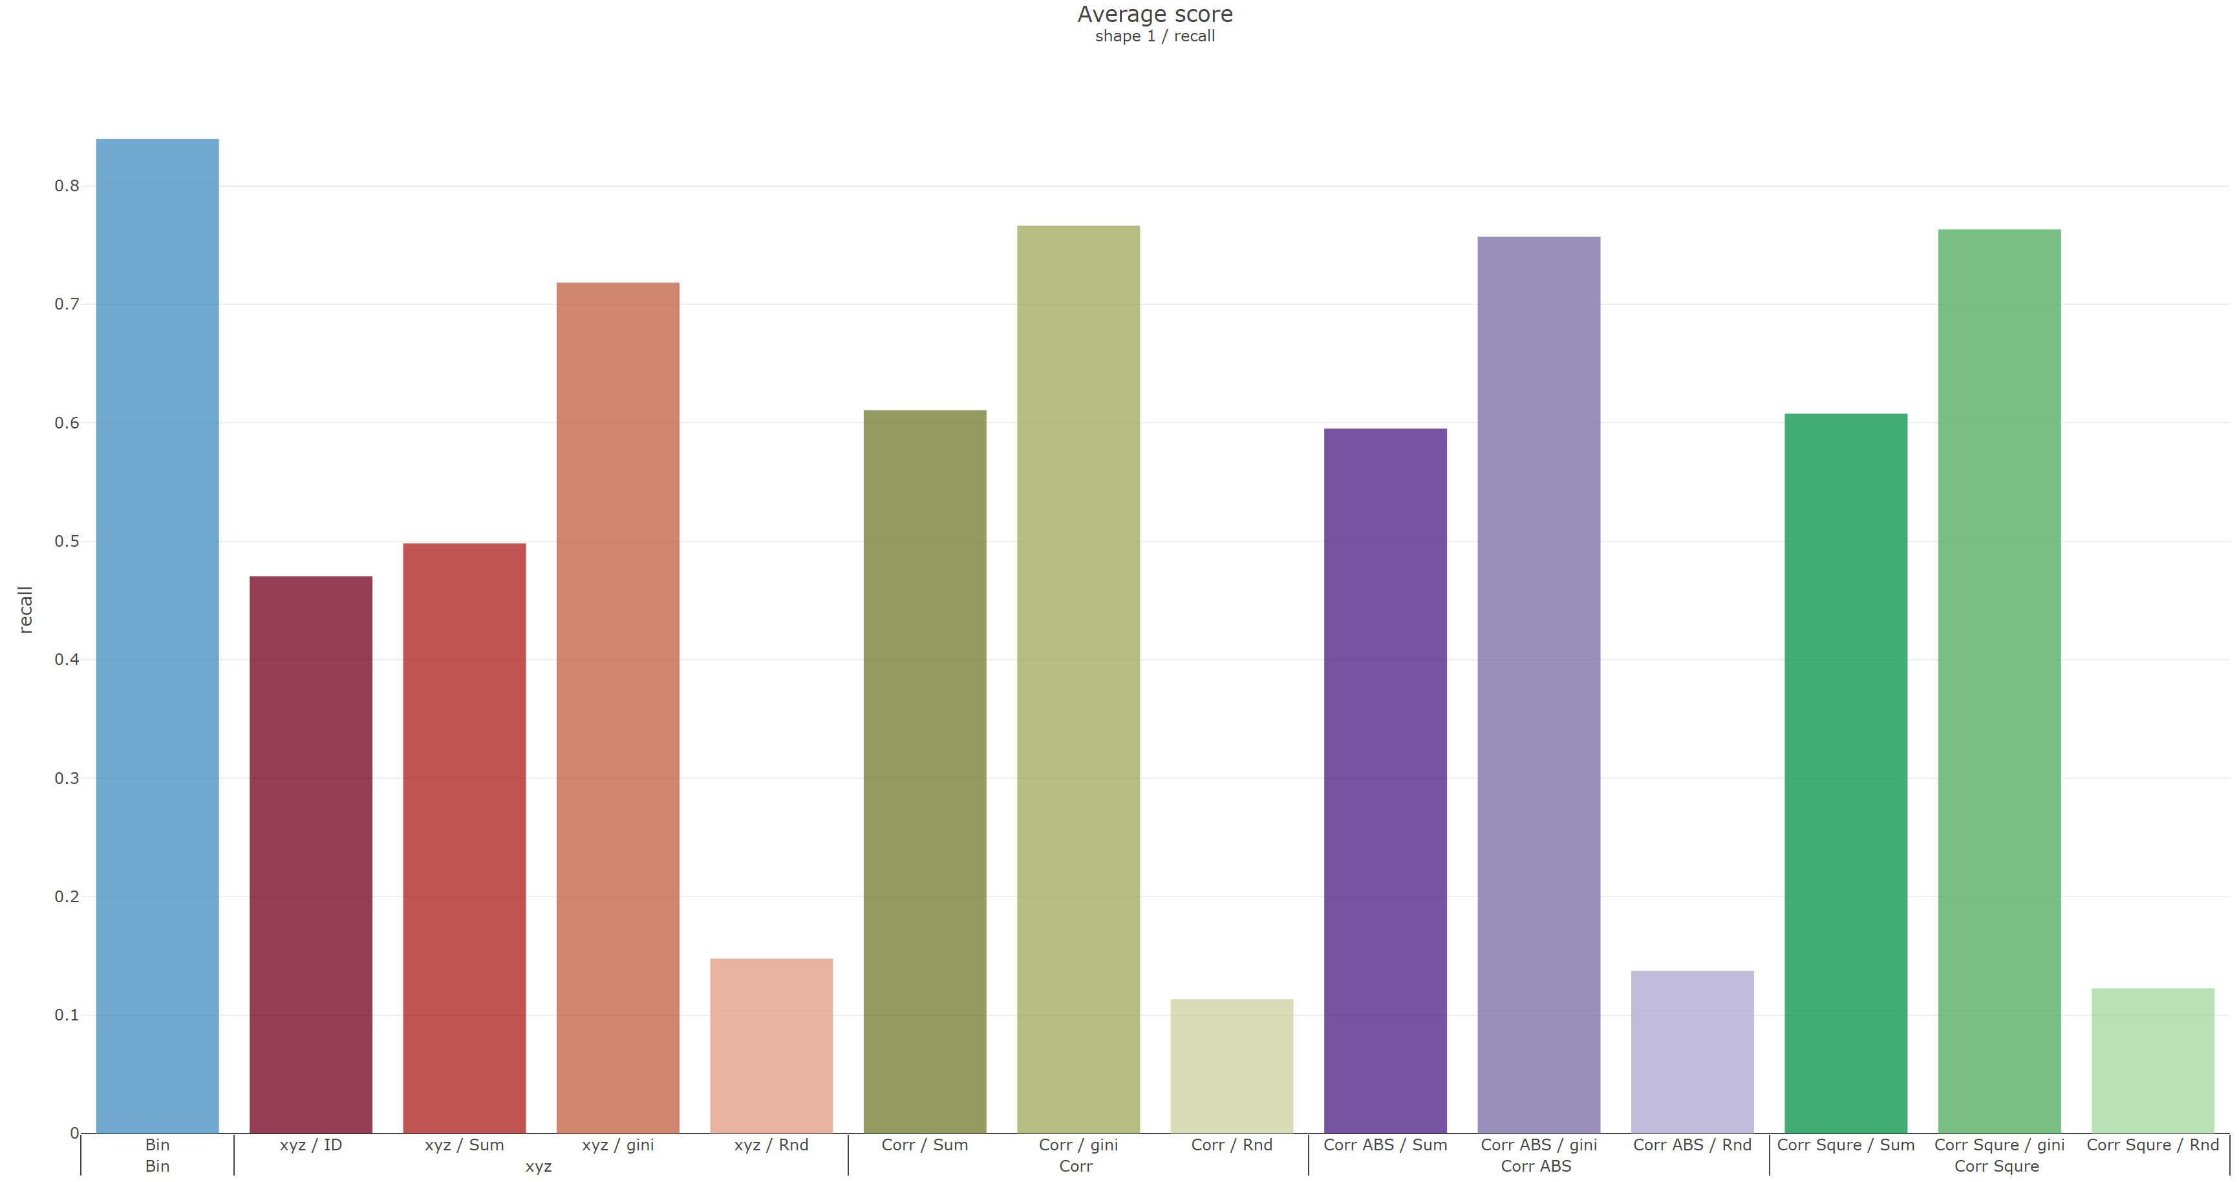
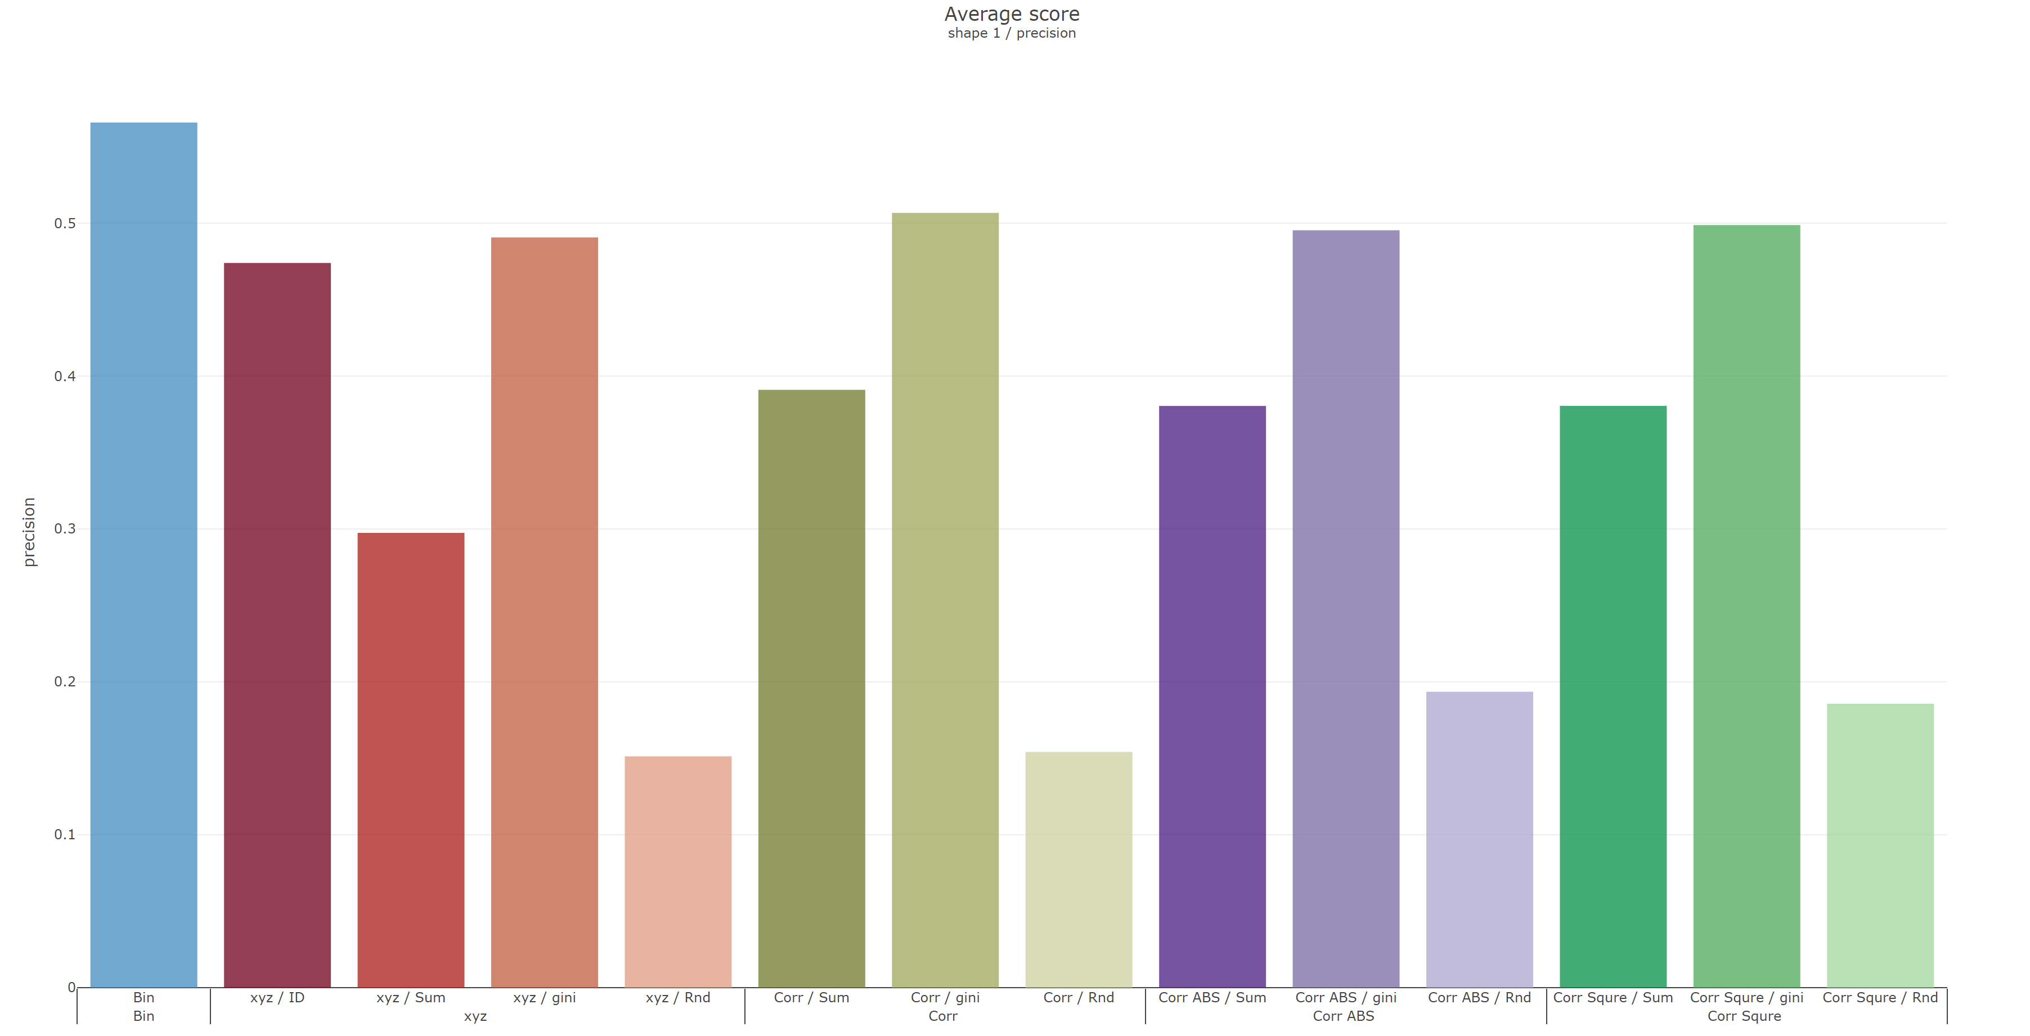
Shape 1
 | Recall | Precision
Reverse
Original

Slide 3
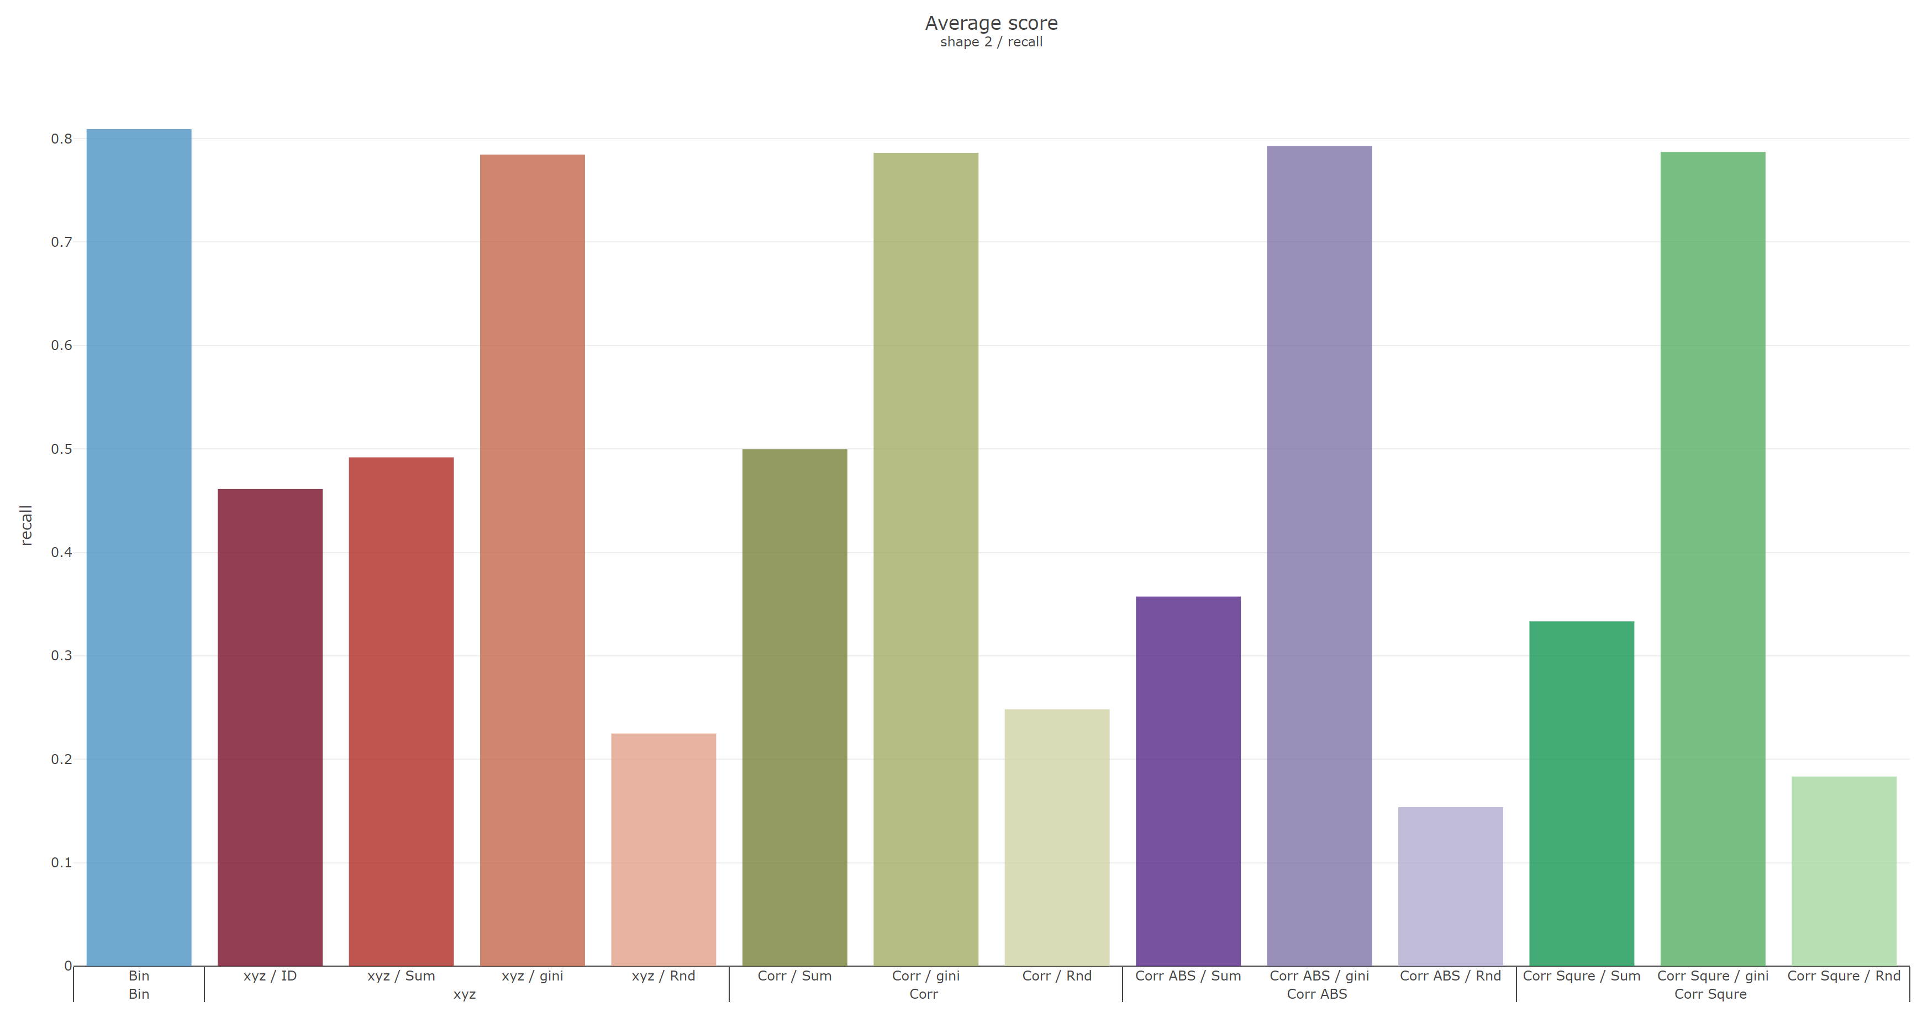
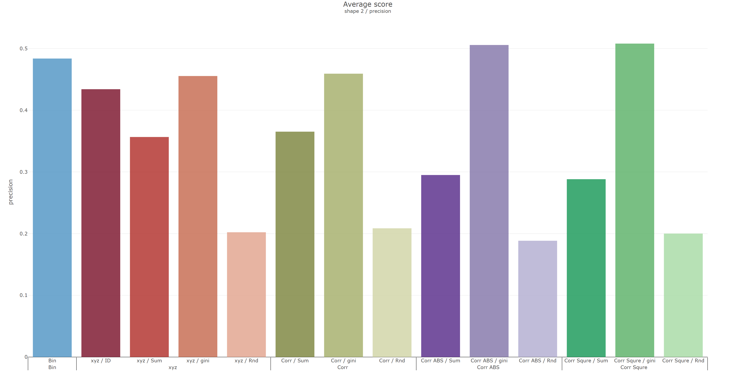
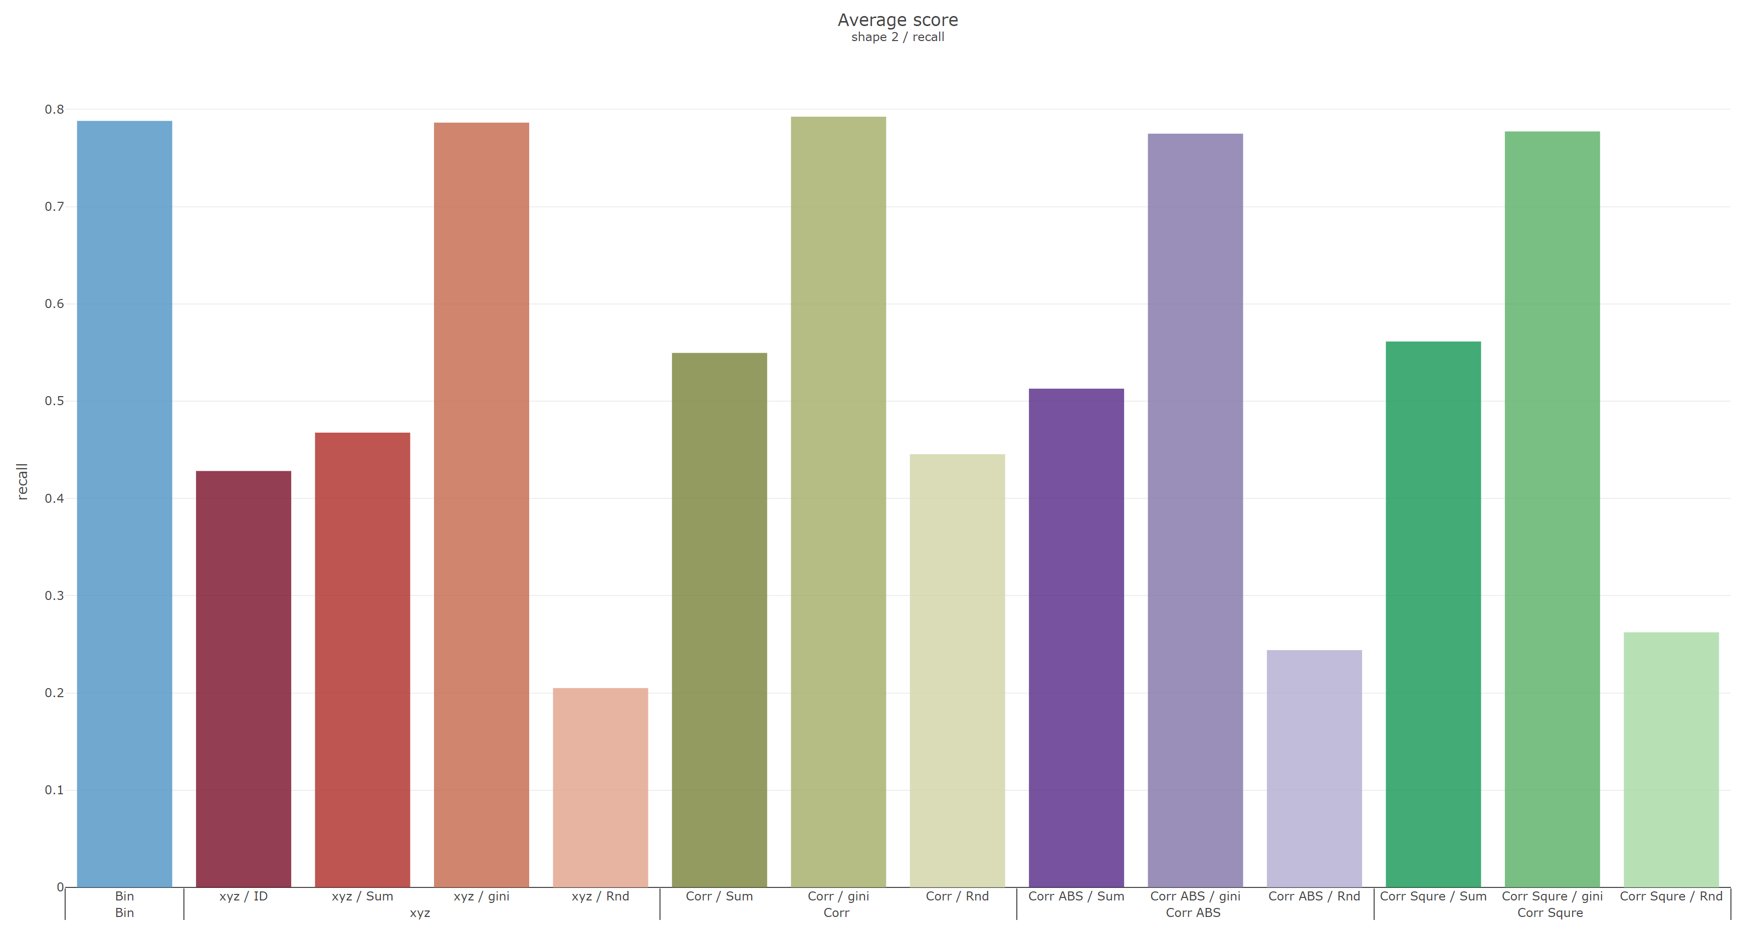
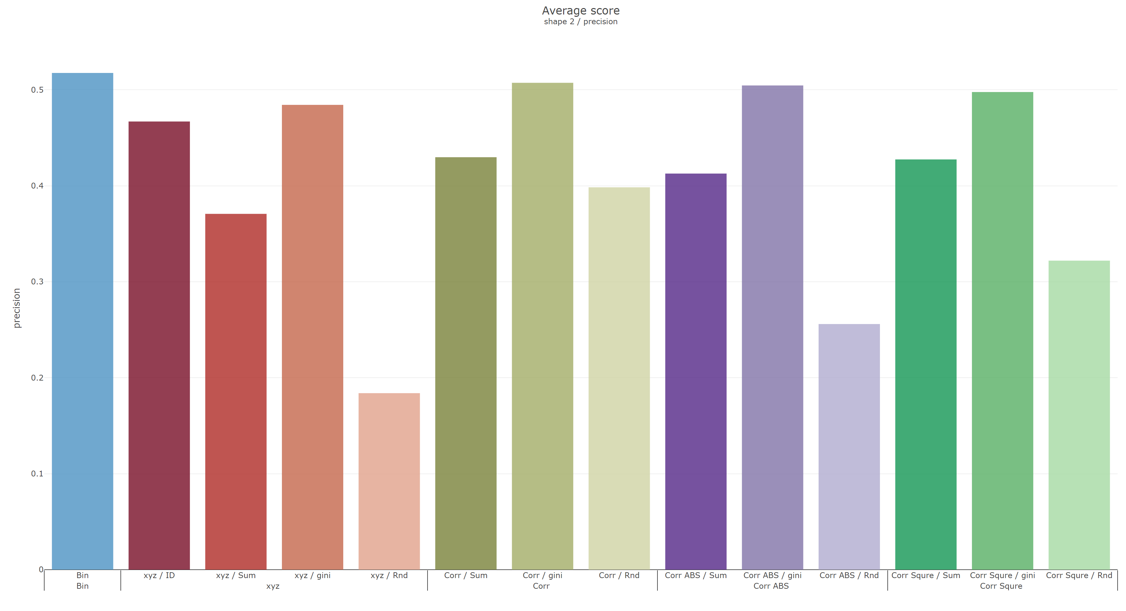
Shape 2
 | Recall | Precision
Reverse
Original

Slide 4
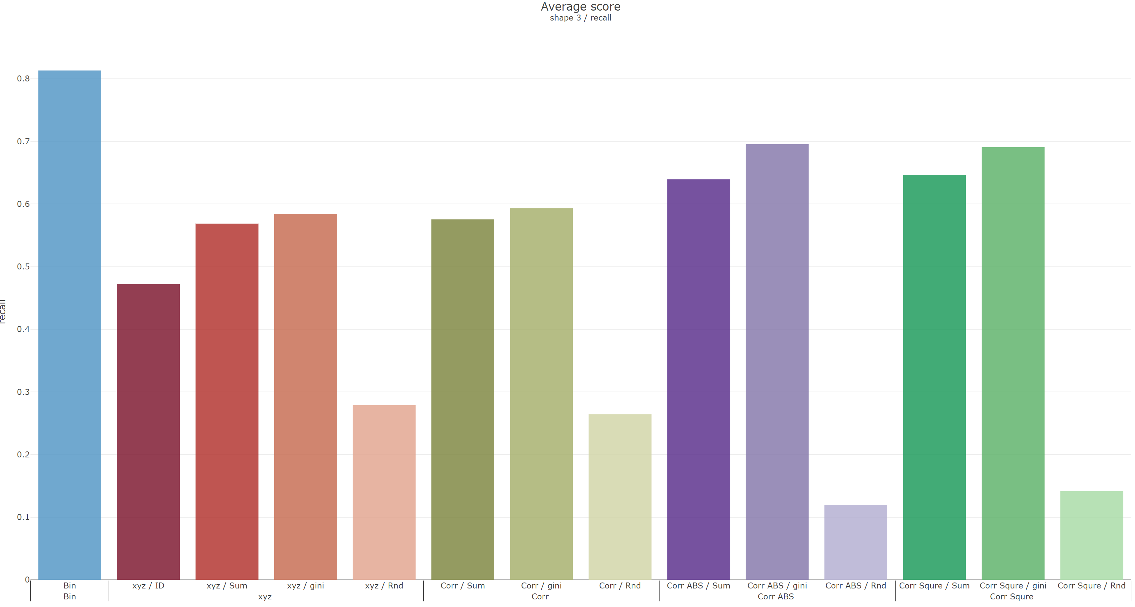
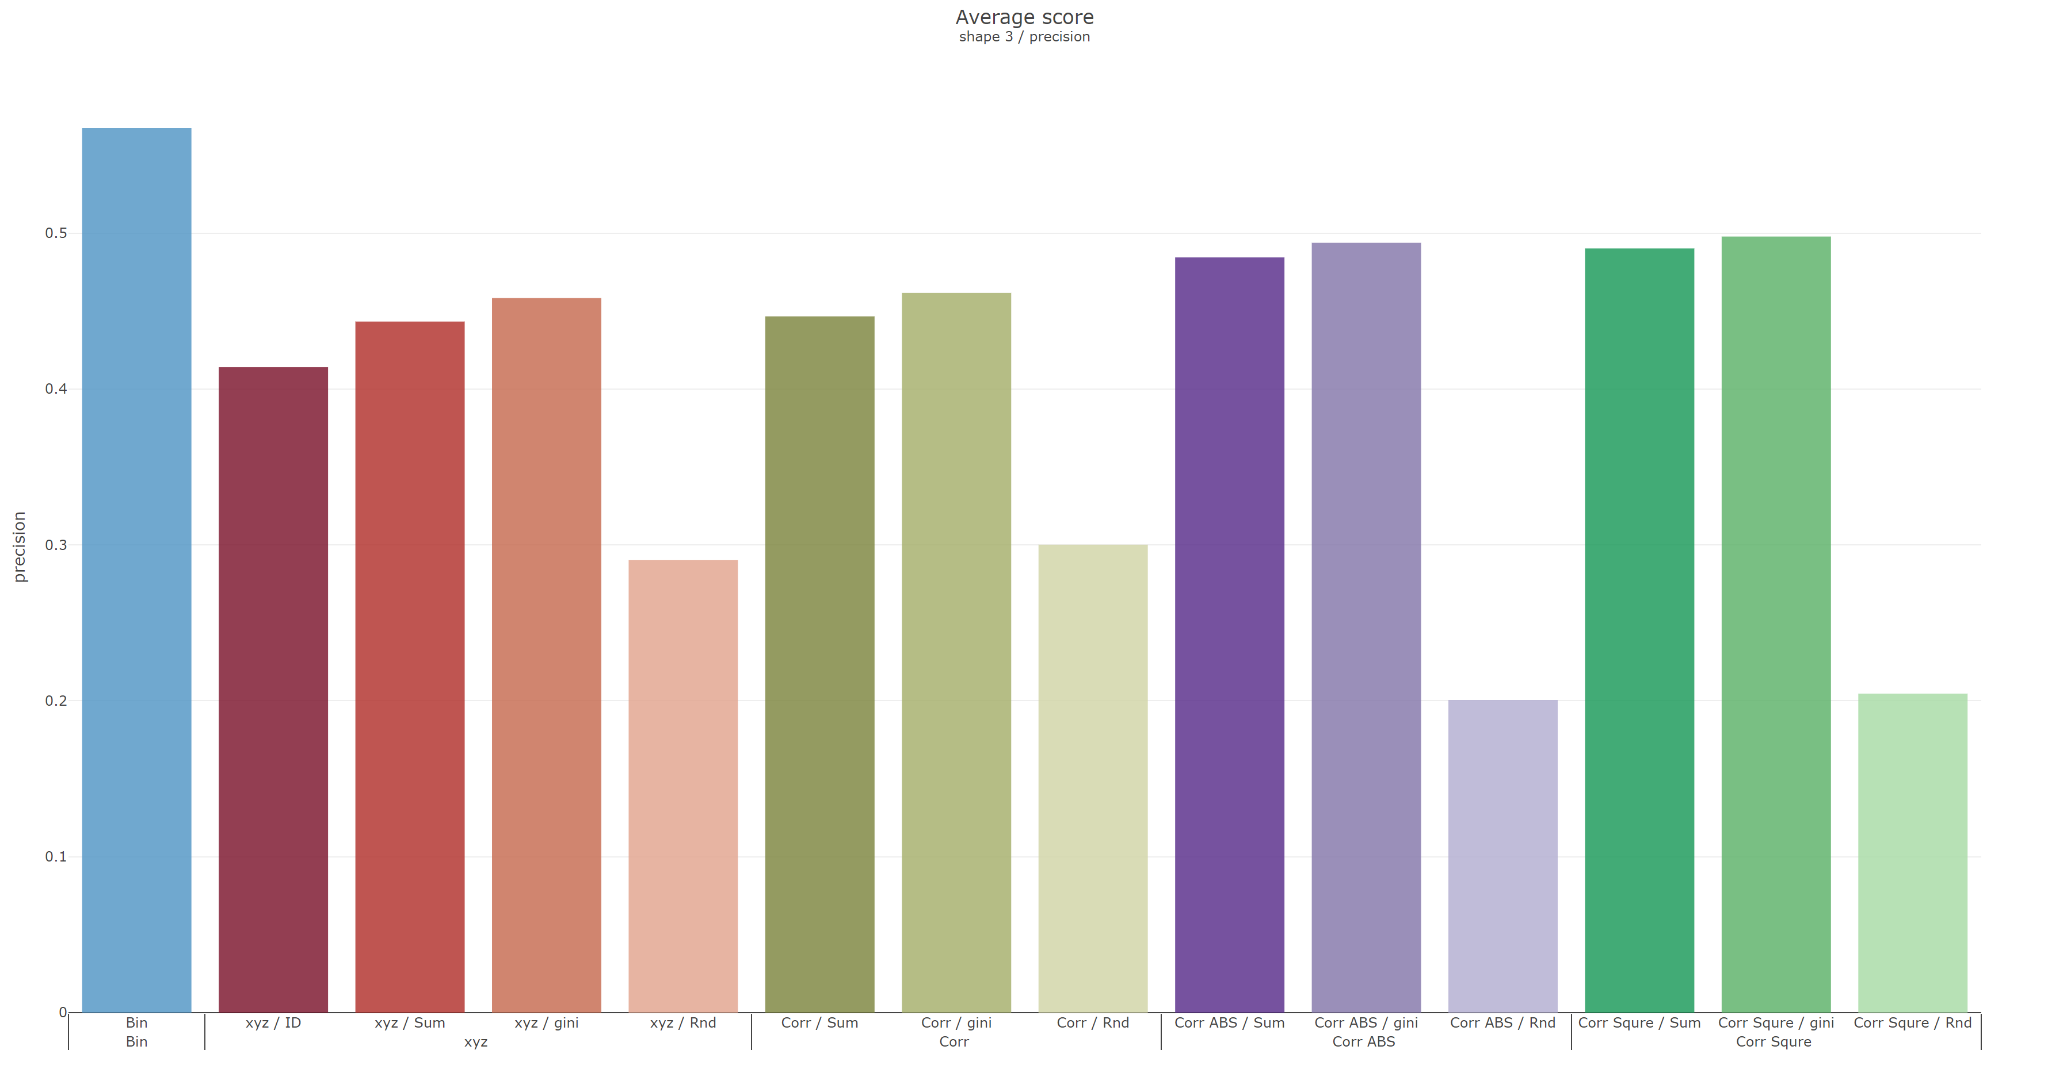
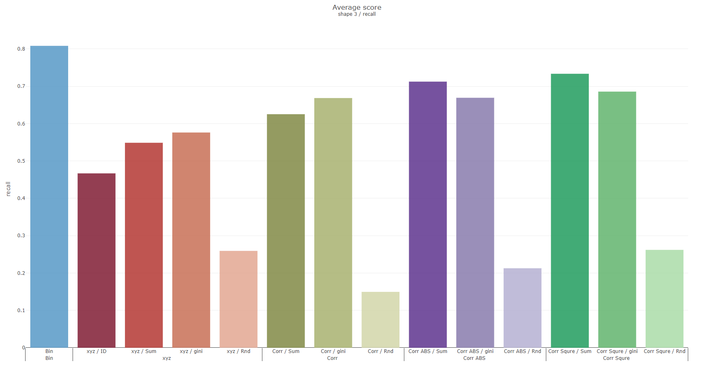
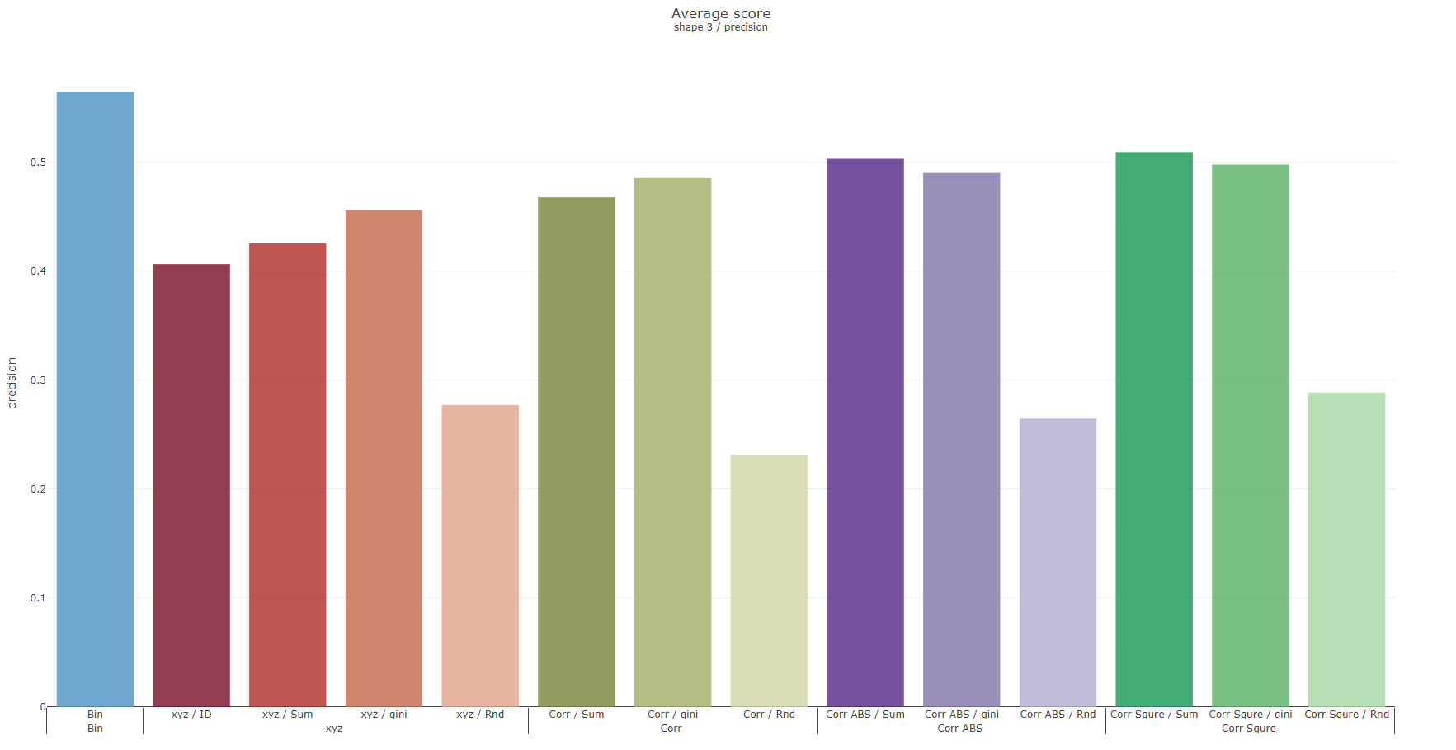
Shape 3
 | Recall | Precision
Reverse
Original

Slide 5
Grouping with columns sequence
S sorting
G-1 | G-2 | G-3 | G-4 | G-5 | G-6 | G-7
G-14 | G-13 | G-12 | G-11 | G-10 | G-9 | G-8
G-15 | G-16 | G-17 | G-18 | G-19 | G-20 | G-21
Notes:
K-fold deviation
Hybird dataset(cont., binary)
UCI
確認遠端還是實體口試

Slide 6
Record K-fold deviation
Grouping with columns sequence
Testing hybrid dataset(both cont. and bin.) on UCI
Make sure remote or physical oral test

Slide 7
Weekly Progress
Classification
Record K-fold deviation
Compared with ordinal, and mean encoding
Testing with UCI datasets on 4, and 10-folds
Car Evaluation Data Set
Adult Data Set
Grouping with columns sequence
Try with others UCI datasets

Slide 8
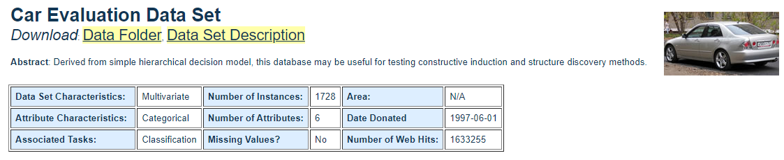
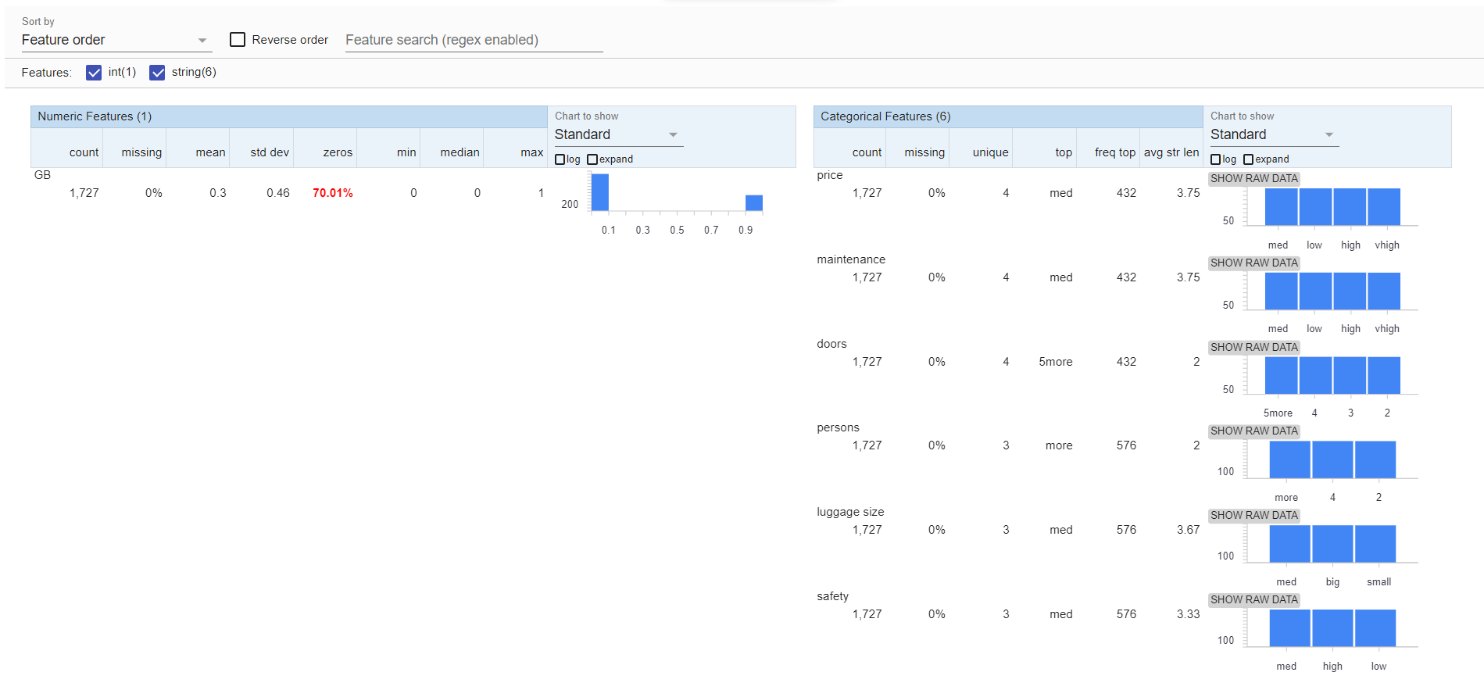
Car Evaluation Data Set

Slide 9
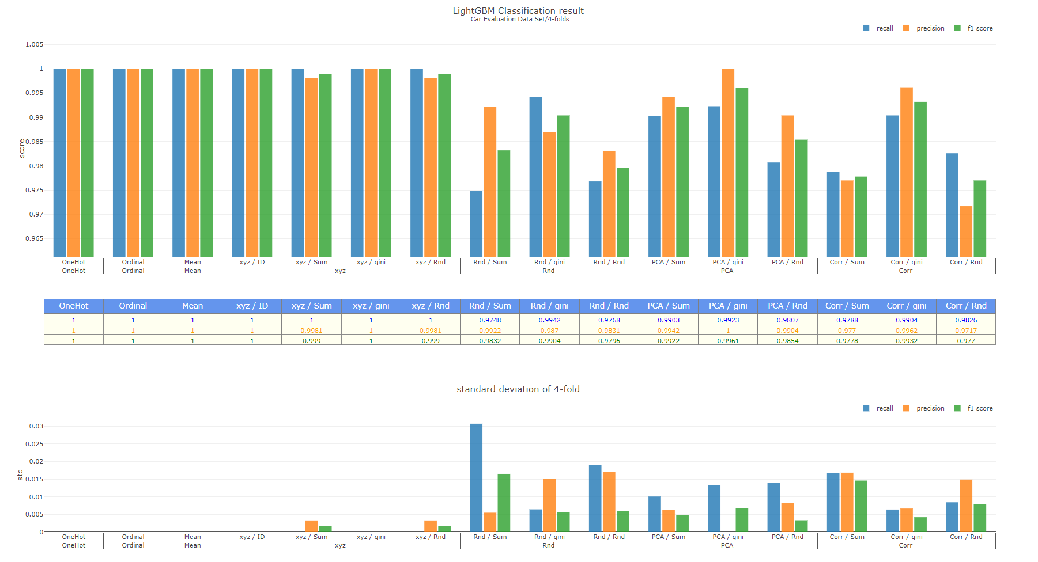

Slide 10
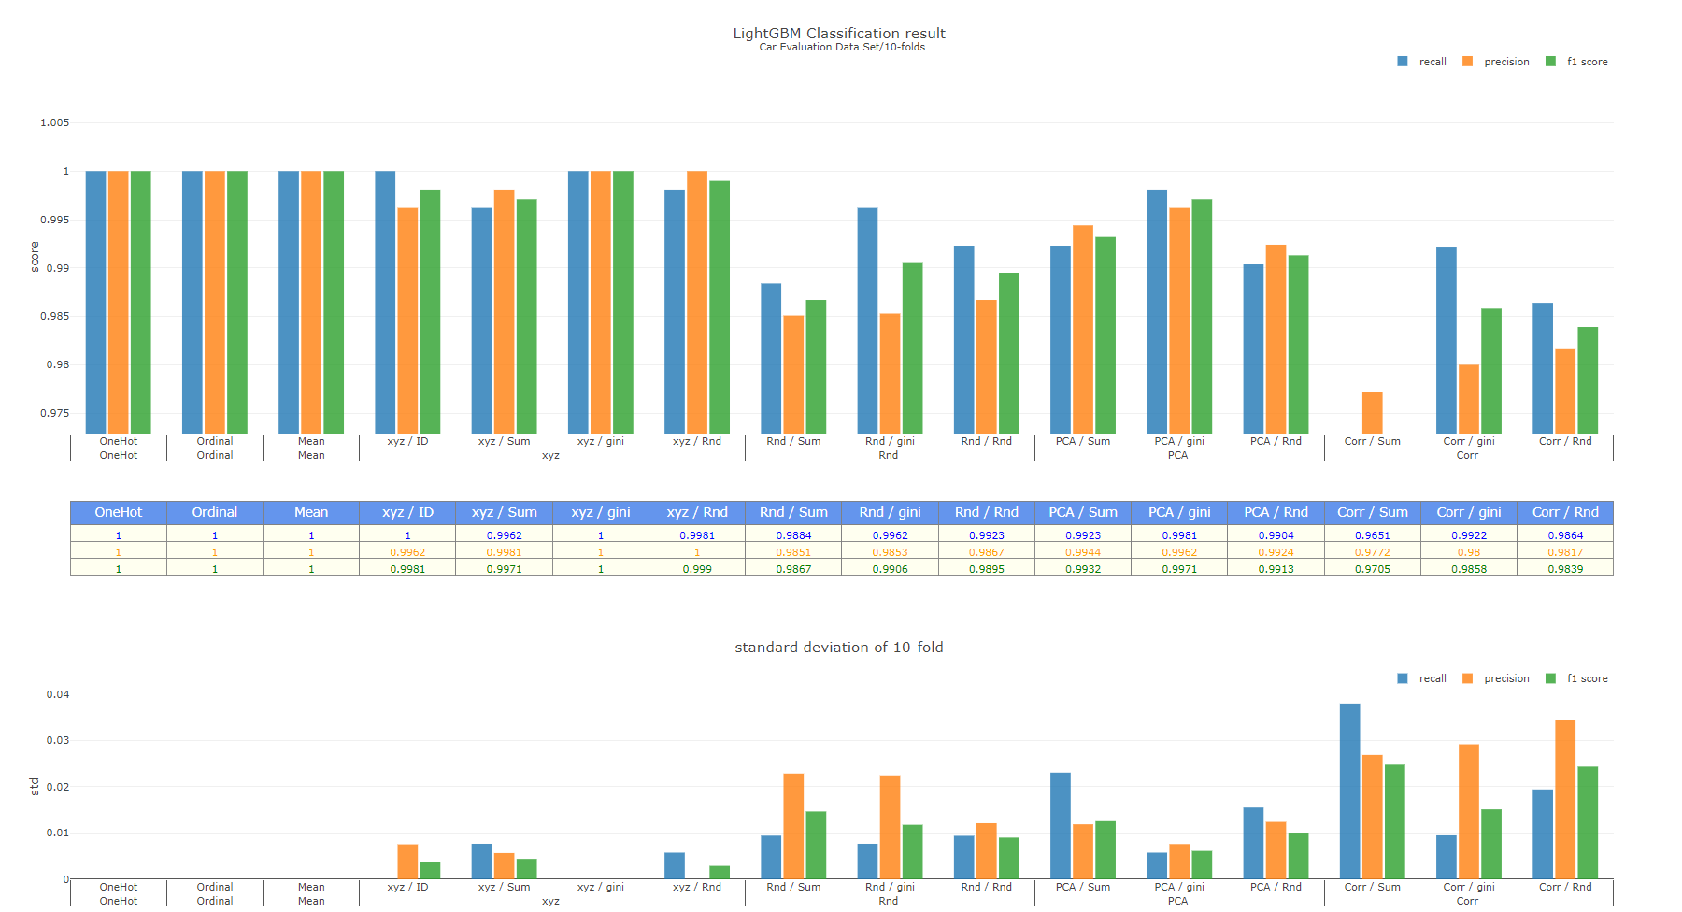

Slide 11
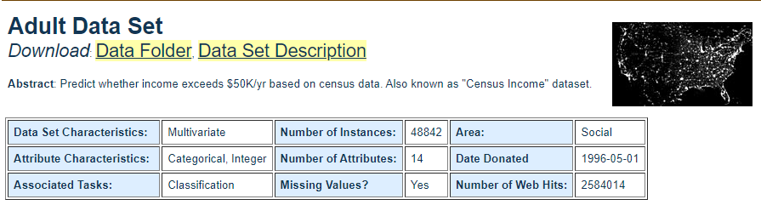
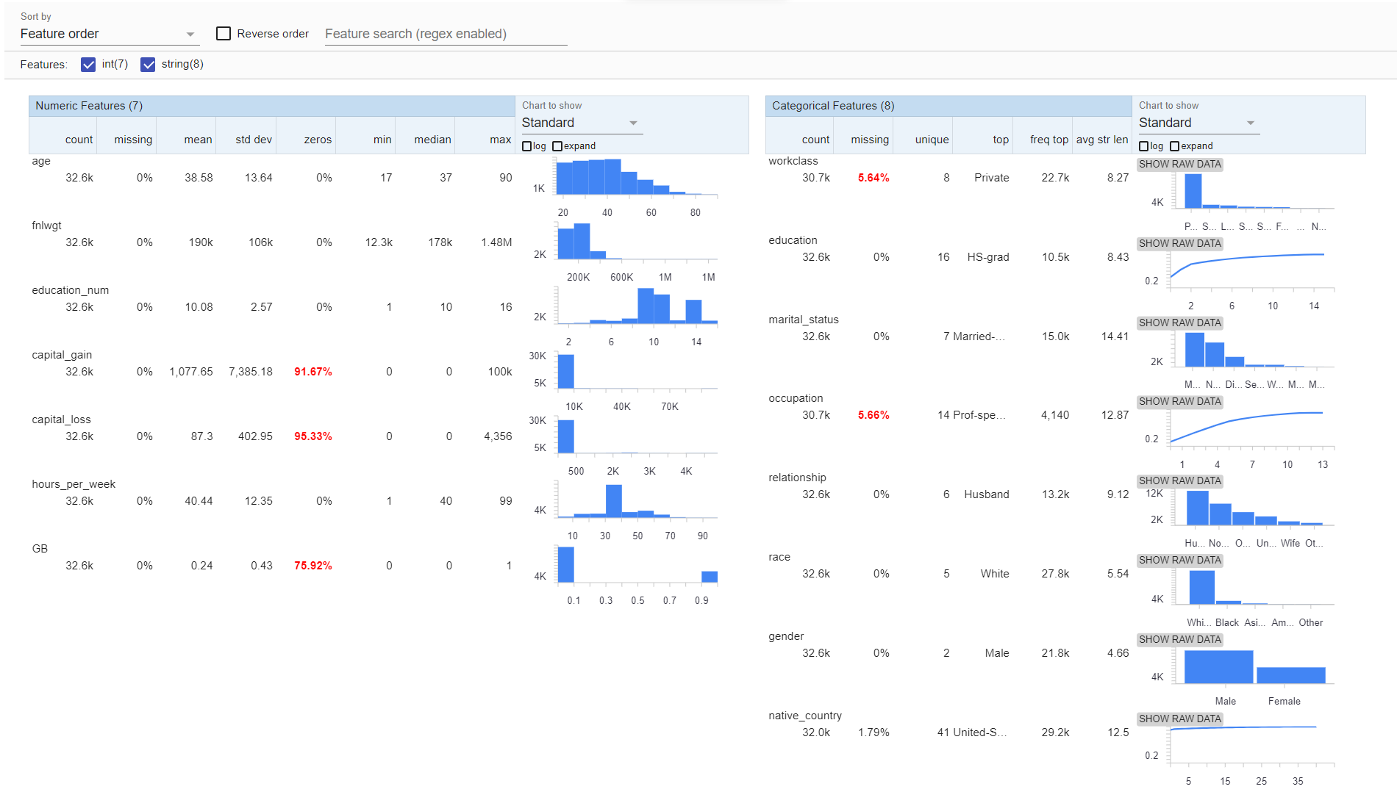
Adult Data Set

Slide 12
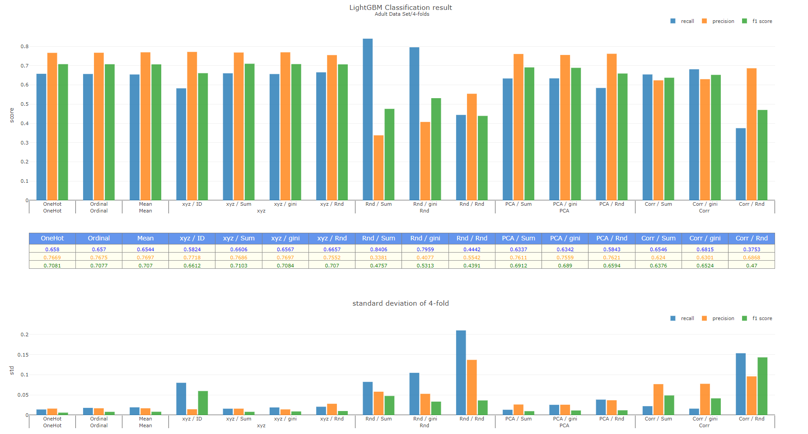

Slide 13
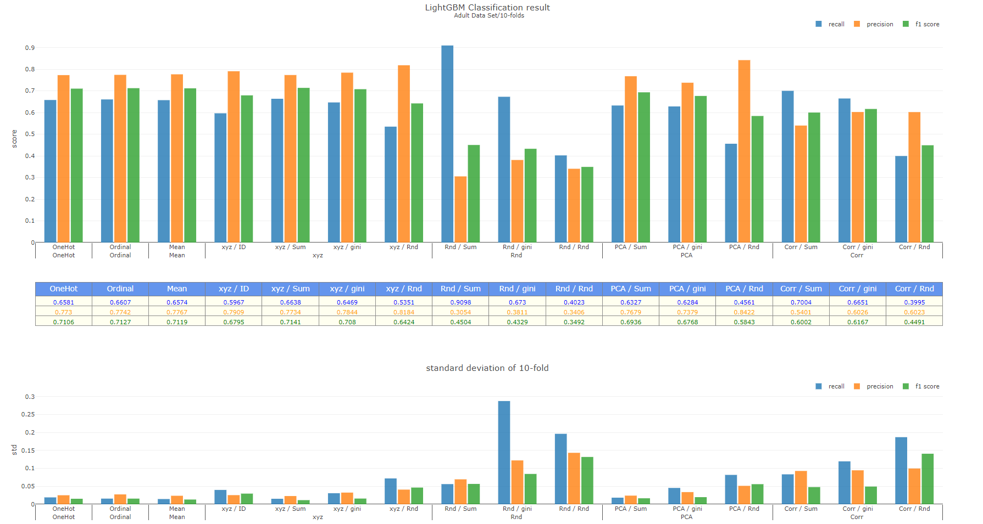
Notes:
Feature importance
AUO data
Imbalance
Kaggle, PWC
信用卡盜刷
目錄

Slide 14
To-do
Datasets
AUO data
Imbalance (Kaggle, UCI, paper with code)
信用卡盜刷
Classification
Record feature importance
Thesis
Chapter 3,4 目錄

Slide 15
緒論
文獻回顧
研究方法
案例分析
結論與建議

